Slide 1
A Decision Support System for understanding the importance of Two-dosage Vaccination
Presented By:
Saranya R,
Department of Applied Mathematics and Computational Science,
Thiagarajar College of Engineering, Madurai. saranyarajagopal2002@gmail.com

Slide 2
INTRODUCTION
Coronavirus disease is a viral infection caused by the Coronavirus. Corona virus infection causes mild to severe respiratory issues in those who are infected.
The Covishield and Covaxin vaccinations are widely used in India to protect against the virus.
Some people, however, do not believe in immunizations. Our immunity systems against COVID-19 will improve if people get the immunizations recommended by the WHO (World Health Organization).
We apply a machine learning technique in this work to boost people's trust in each other.

Slide 3
ABSTRACT
In COVID 19, immunization plays a critical impact in reducing death rates. Certain people, however, are skeptical of vaccines like covaxin and Covishield.
To make decisions about vaccines like covaxin and Covishield, a decision support system (DSS) based on machine learning is required.
People can grasp the usage of COVID 19 Vaccines with the use of machine learning models.
To construct a Decision Support System, supervised machine learning models are used. Logistic Regression, Decision Tree and Random Forest are the supervised machine learning models that helps in prediction of death rate as well as the grasp the value of vaccination.

Slide 4
RELATED RESEARCH
Aggarwal, L., Goswami, P., & Sachdeva, S. (2021) - In this paper, susceptible, exposed, infected, and recovered were used to test an additive utility assumption-based strategy for a multi-criterion decision support system. Comparative analysis with parameters such as Precision, Recall, and F-Score is included in the results.
Kwekha-Rashid, A. S., Abduljabbar, H. N., & Alhayani, B. (2021). – This paper has used supervised learning givens the best result than unsupervised model in machine learning algorithms for the health center programs and COVID-19 cases.
Pourhomayoun, M., & Shakibi, M. (2020). – This paper has chosen some machine learning algorithms like Support Vector Machine (SVM), Artificial Neural Networks, Random Forest, Decision Tree, Logistic Regression, and KNearest Neighbour (KNN) algorithms to find out the death rate caused by COVID-19 and uses confusion matrix for finding sensitivity.

Slide 5
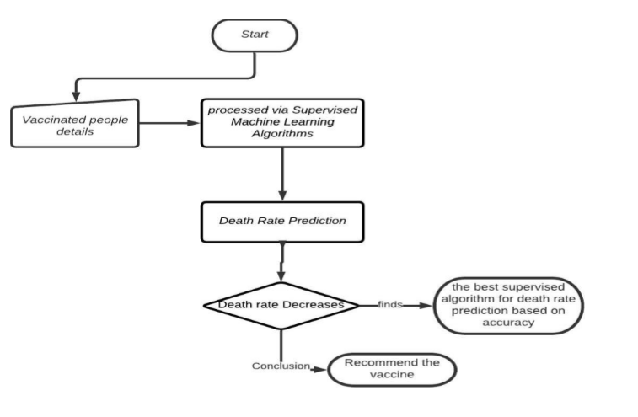
SYSTEM ARCHITECTURE

Slide 6
MACHINE LEARNING
Machine learning is the process of allowing computers to learn on their own using data and algorithms. Supervised learning, unsupervised learning, and reinforcement learning are all types of machine learning.
The type of machine learning in which machines are trained using well-labeled training data is known as supervised learning.
This tagged data collection is used to make predictions in this situation. This prediction is based on the number of persons who have been vaccinated and the death dates.
A supervised learning algorithm analyzes the training data and produces an inferred function, which can be used for mapping new examples.
Here we have used Decision tree and Random Forest algorithms are used under classification type prediction and Logistic Regression under Regression type prediction.

Slide 7
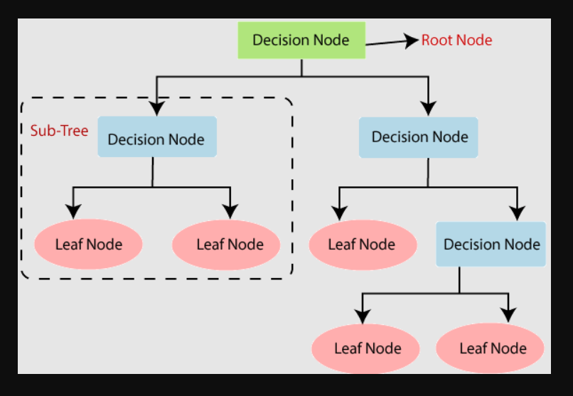
DECISION TREE
In the form structure of the tree, Decision Tree creates a model. The data set is broken down into smaller and smaller subsets, but an association of decision trees has been formed throughout the same time period.
Decision tree regression observes features of an object and trains a model in the structure of a tree to predict data in the future to produce meaningful continuous output.

Slide 8
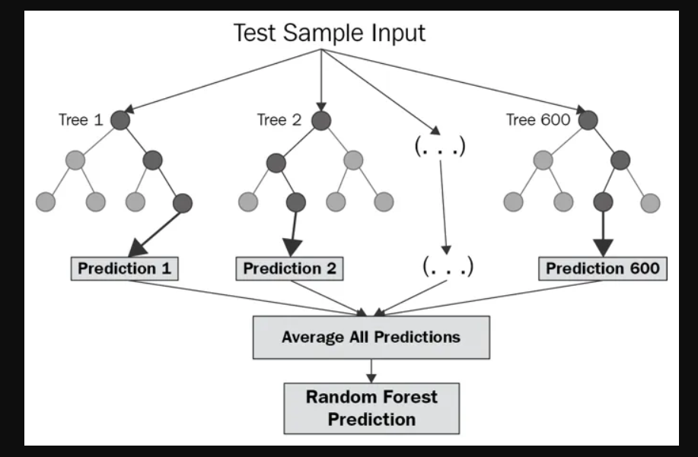
RANDOM FOREST TREE
Random forest is a flexible, easy to use machine learning algorithm that produces, even without hyper-parameter tuning, a great result most of the time.
Random Forest chooses a random sample from the data, and the algorithm builds a Decision tree for each sample. Finally, consider the class that is in the mode of all the outputs from each decision tree's mean predictions.

Slide 9
LOGISTIC REGRESSION
Logistic Regression is a Machine Learning algorithm which is used for the classification problems, it is a predictive analysis algorithm and based on the concept of probability.

Slide 10
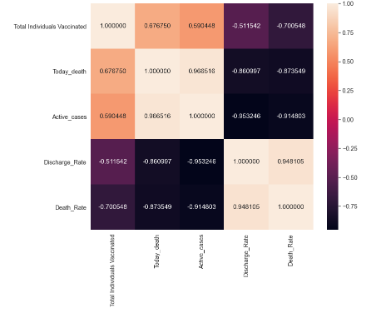
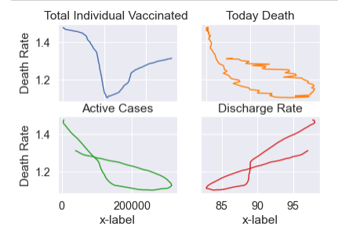
Heap graph represents the correlation between the death rate and other important factors like active cases, death rate etc.
This subplot graph represents the trend of vaccination on a particular duration with respect to death rate.

Slide 11
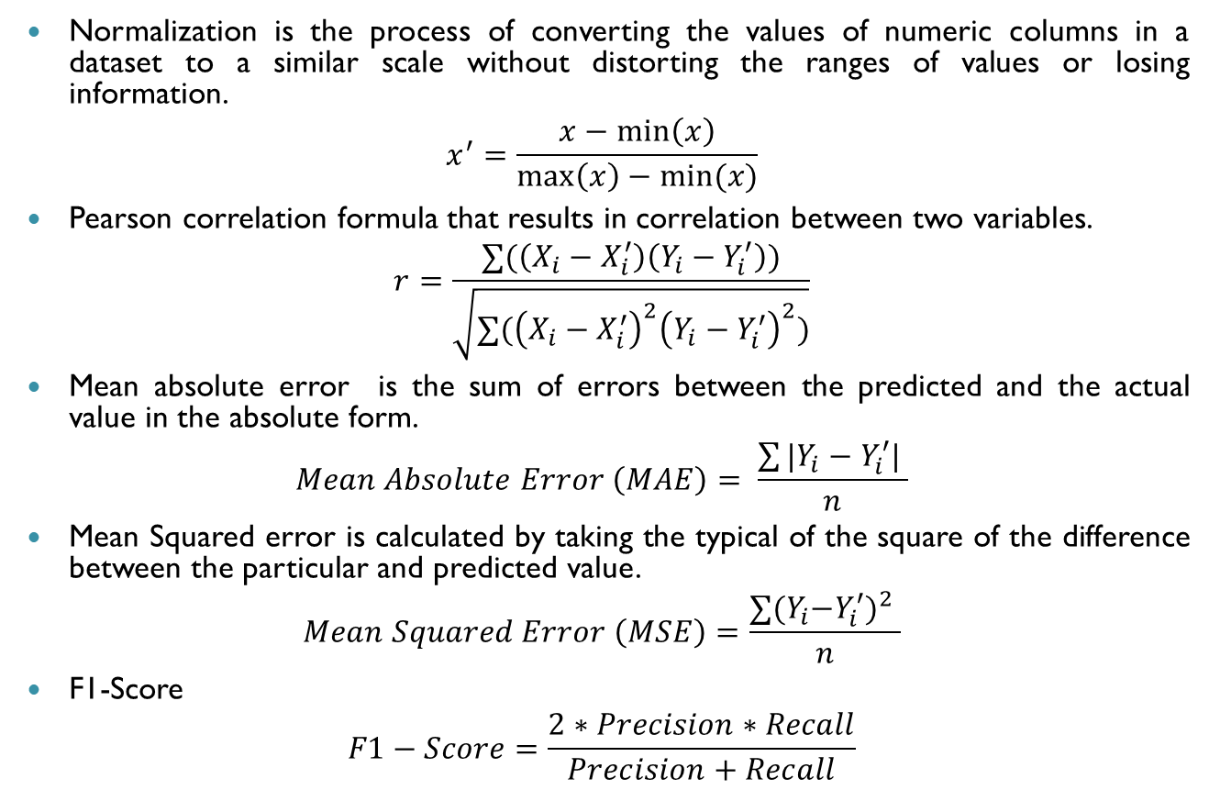
EVALUATION PARAMETER
Normalization is the process of converting the values of numeric columns in a dataset to a similar scale without distorting the ranges of values or losing information.
$$x^{′}=\frac{x−\min\left(x\right)}{\max\left(x\right)−min⁡(x)}$$
Pearson correlation formula that results in correlation between two variables.
$$r=\frac{∑(\left(X_{i}−X_{i}^{′}\right)\left(Y_{i}−Y_{i}^{′}\right))}{\sqrt{{∑(\left(X_{i}−X_{i}^{′}\right)}^{2}{\left(Y_{i}−Y_{i}^{′}\right)}^{2})}}$$
Mean absolute error is the sum of errors between the predicted and the actual value in the absolute form.
$$Mean Absolute Error \left(MAE\right)= \frac{\sum{|Y_{i}−Y_{i}^{′}| }}{n}$$
Mean Squared error is calculated by taking the typical of the square of the difference between the particular and predicted value.
$$Mean Squared Error \left(MSE\right)=\frac{∑{{(Y}_{i}−Y_{i}^{′})}^{2} }{n}$$
F1-Score
$$F1−Score=\frac{2∗Precision∗Recall}{Precision+Recall}$$

Slide 12
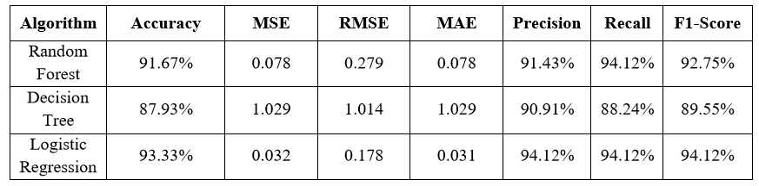
RESULT
COVID-19 is the current pandemic disease posing a threat to medical professionals. We infer that as the number of people immunized grows, the death rate drops.
According to this forecast, the person who has been vaccinated will have a far lower death rate. This approach suggested a solution for recommending vaccines to persons who are uninformed of their importance and benefits.

Slide 13
CONCLUSION
Here we conclude that the death rate decreases as the number of individuals vaccinated increases. From this prediction, the person vaccinated will have a very less death rate.
This Decision Support System recommend people to get vaccinated to add immunity so that death rate decreases automatically.

Slide 14


